Slide 1
Chapter 4
The Laws of Motion
The Third Law of Motion

Slide 2
The Third Law of Motion
What happens if you push against a sturdy wall?
But what happens if you pushed against that same wall while you were wearing roller skates?
What would happen if you pushed even harder?

Slide 3
The Third Law of Motion
The backwards movement that resulted from pushing on the wall is because of Newton’s third law of motion
When one object exerts a force on a second object, the second object exerts a force on the first that is equal in strength and opposite in direction
In other words, for every action/force, there is an equal and opposite reaction/force

Slide 4
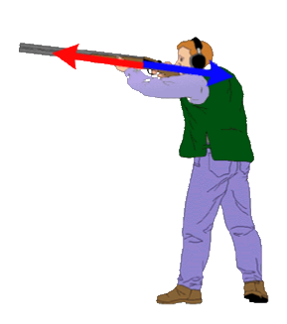
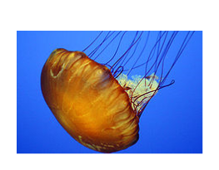
What do these pictures have to do with the 3rd Law of Motion?

Slide 5
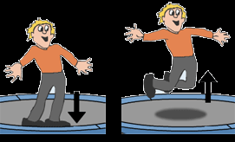
The Third Law of Motion
Action and Reaction
When a force is applied, a reaction happens at the same time
Example: when you jump on a trampoline, you are exerting a downward force on it. At the same time, the trampoline is exerting an equal force in the oppose/upward direction on you, so you are being sent high in to the air

Slide 6
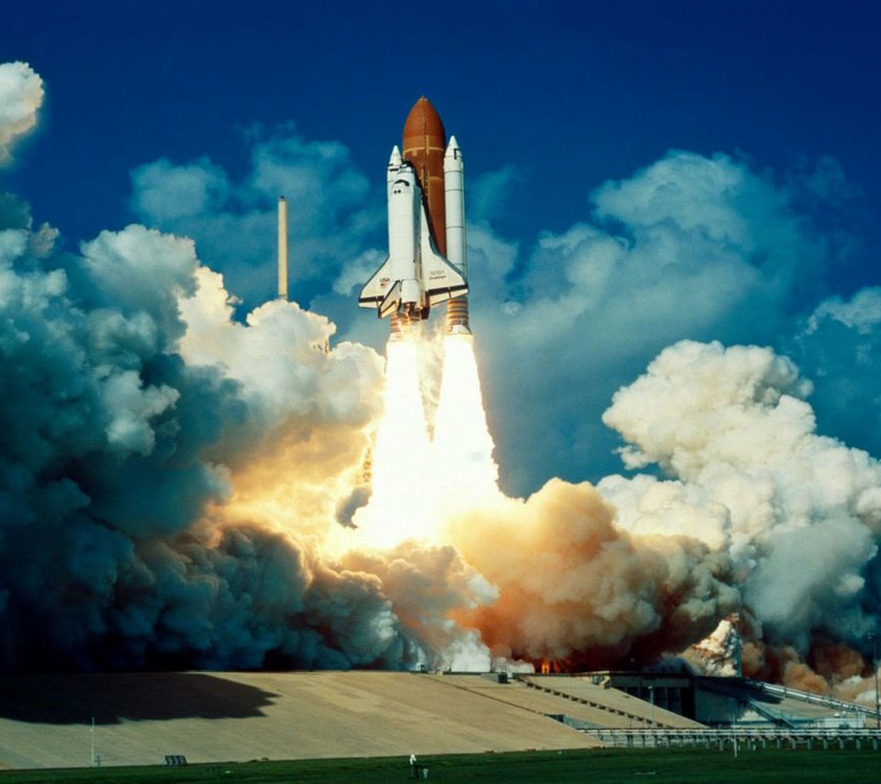
The Third Law of Motion
This is how rockets work
In the engine, burning fuel produces hot gases
The rocket engine exerts a force on these gases and causes them to escape out the back of the rocket
These gases exert a force on the rocket and push it forward/upward

Slide 7
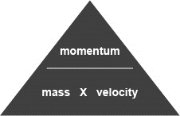
The Third Law of Motion
Anything that moves has a property called momentum that is related to how much force is needed to change its motion
Momentum is the product of its mass and velocity and is symbolized by the letter p
Units are kg x m/s
Use the formula
Momentum
Momentum (kg x m/s) = mass (kg) x velocity (m/s)
p = mv
Objects with more mass and/or more velocity will have a larger momentum
A ballet director assigns slow, graceful steps to larger dancers, and quick movements to smaller dancers. Why is this plan successful?
(p)

Slide 8
The Third Law of Motion
At the end of a race, a sprinter with a mass of 80 kg has a speed of 10 m/s. What is the sprinter’s momentum?
p = ?
m = 80 kg
v = 10 m/s
p = mv = (80 kg)(10 m/s) = 800 kg x m/s
(p)

Slide 9
The Third Law of Motion
A baseball thrown by a pitcher has a momentum of 6.0 kg x m/s. If the baseball’s mass is .15 kg, what is the baseball’s speed?
p =
m =
v =
What is the mass of a person walking at a speed of .8 m/s if their momentum is 52.0 kg x m/s?
p =
m =
v =
(p)

Slide 10
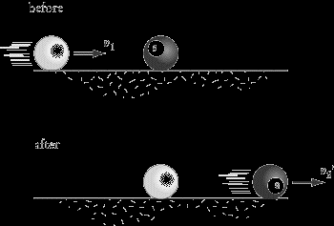
The Third Law of Motion
Law of Conservation of Momentum
The momentum of an object doesn’t change unless its mass, velocity, or both change
However, you can transfer momentum from one object to another
In this picture, the cue ball has momentum because it is moving with a certain velocity. The 8-ball is motionless.
When the cue ball hits the 8-ball, it slows down and the 8-ball begins to move.
The momentum the 8-ball gained is equal to the momentum the cue ball lost.
We say that momentum is conserved (aka saved)
This is the law of conservation of momentum

